Slide 1
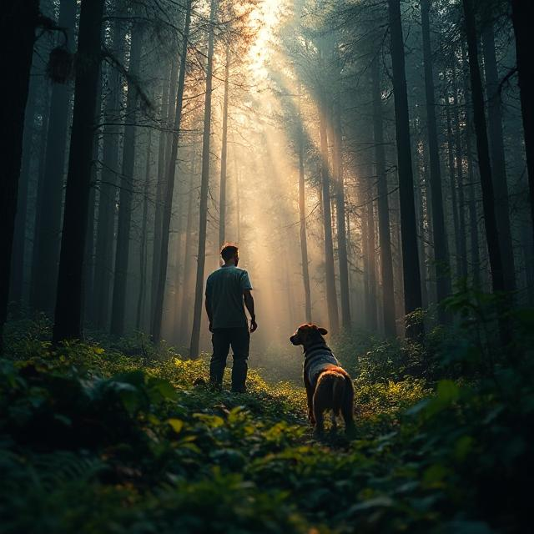
Survivor In The Wilderness
Text-based game made with Python
Group Name:
Fithon Coders
Image generated with DeepAI

Slide 2
Our Team
Makai Trott - Project Manager
Dylan Tong - Lead Developer
Sheikh Hussain - Project Coordinator
Fehintola Ogenah - Quality Assurance

Slide 3
Note:
No bullets points have been used throughout this slide to represent our answers to the questions in the brief as per the presentation brief requirements

Slide 4
Our Game
Story
Set in the wilderness, our game is based on a character who has become lost. He goes to forage and scavenge while he completes smaller tasks. Each time he ventures out he is able to do something that impacts his stats. The goal for him is to find another survivor and get out of the wilderness.
Endings
With it being an RPG adventure game, the only real ending for our game is that he has his stats improved for the next day. We want this game to be continued by someone else. However, for our day - we have made it so that certain decisions within the game would unlock mysteries for him to use and then solve which gives it 2 possible endings. One where he unlocks the secret and one where he doesn’t.
Characters
The character in our game is only focused around the main individual, we really wanted to stick to the theme of our game idea. However, we do begin to introduce the potential of finding another character early on in the game creating the assumption that you might find someone else. Other than this, The only other characters in the game are the animals that you fight and have the potential to losing to.

Slide 5
Key Features
Are there any features you have that are unique?
The key feature of our game that makes it unique is the mystery section we have included throughout our game. In addition to such, the story and the game itself is built so that another person in the future who maybe working on the same project at the same institution could further develop our storyline. We wanted to create that open space so it was something that just continues to be developed over time.
Were there any others you wanted to add?
As with all our brainstorming sessions, we always had different ideas. Like placing another character in our storyline but we wanted to ground ourselves to the point that this game should be continuous and that for our section we’re building the hype around it first. On that thought, we would cancel out some of our idea’s and key features.

Slide 6
Planning Phase

Slide 7
Planning Phase
Research on text-based games
During this phase of the project, we took a lot at some Python games overall and some text-based games only. This presented us with the idea of what we need our end outcome to look like and what we were making. Some of the games out there play on for hours. We didn’t have enough scope to build something like that, but we needed to achieve the same ‘feel’.
How did you keep ideas organised?
We used our Trello board. We wanted to make sure that all the idea’s we came up with were noted down in a place that is accessible by all of us. This would then create a room for inspiration where if a member needed idea’s they could just visit that place.
How did Trello and Flowcharts help?
Trello and Flowcharts were the backbones to this project. However, with our group being so small - it could be said that most just knew where they were anyway. Trello helped keep us organised and track our own progress. The flowcharts gave us the real design of our game which would aim to work towards when it came to coding. Without our flowcharts we would struggle with implementing ideas that aren't necessary.

Slide 8
Concepts
What ideas did you all have?
We came up with several different ideas but the ones put forth were either a zombie based game or a survival game as these tend to do well. We had to stick to it being a Python Text-Based Game
Who came up with them?
Sheikh did come up with the idea of having the zombie survivor game as he had already been working on one previously. We still wanted something that was unique to us.
Why/how did you cancel them out?
All the brainstorming sessions gave us ample amounts of idea’s but we knew that the game needed the potential to continuously run. We saw an example of a Python text-based game which ran for hours. So we wanted to make sure that we would have something similar though we needed to consider our project objective and/also our individual learning curves.
IDEAS:
Zombie Adventure Game - No
X : Survival Game… Yes
Pictures or ASCII art could be used for death screens, depicting how the player died
? : Chance to miss your attack, different weapons have different 'miss'% - Feature?
X : One time use items, such as powerful weapons or healing items
? : Ability to view and inspect items in your inventory, each with a brief description and stats
X : Small puzzles to unlock secrets (?) - good idea (chest with pin)
Ability to play at night instead of day, this will increase difficulty and change time from PM to AM (?)
X : Simulate the pokemon battle scene

Slide 9
Design & Implement Phase

Slide 10
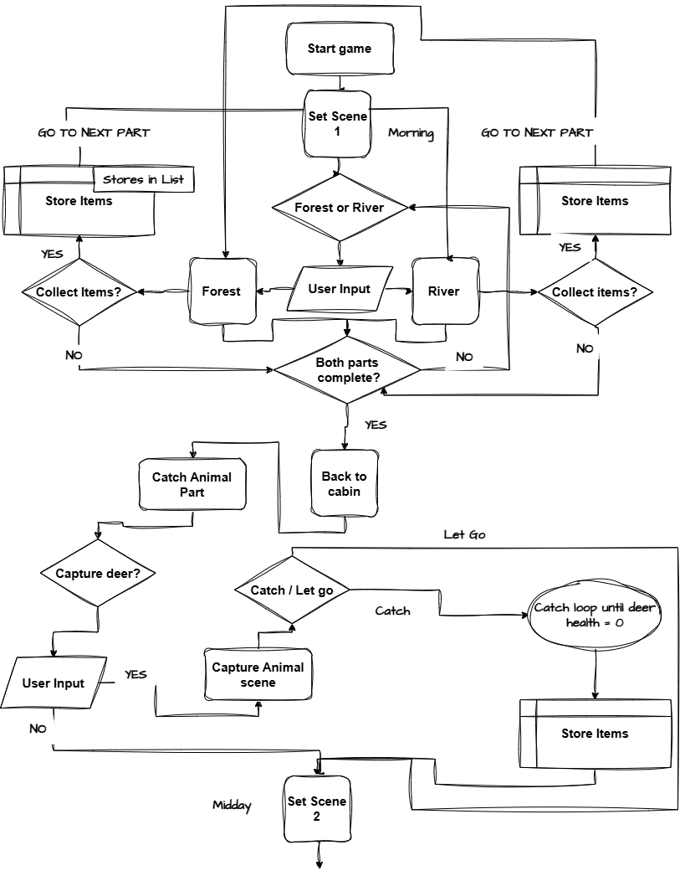
Flowchart
Scene 1

Slide 11
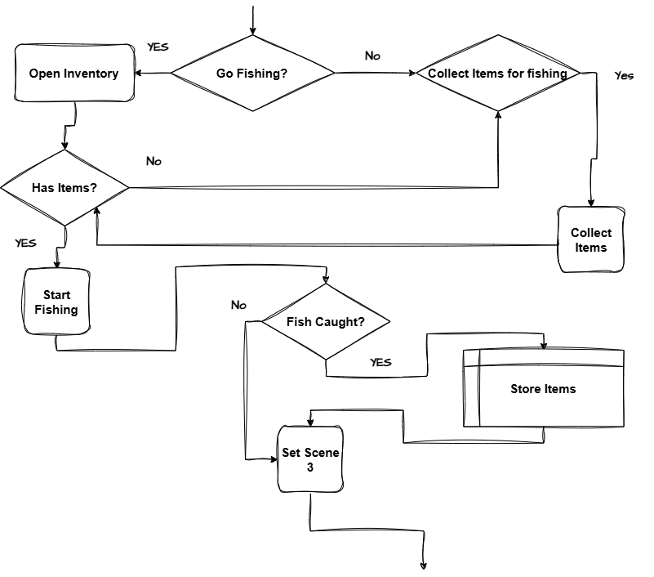
Flowchart
Scene 2

Slide 12
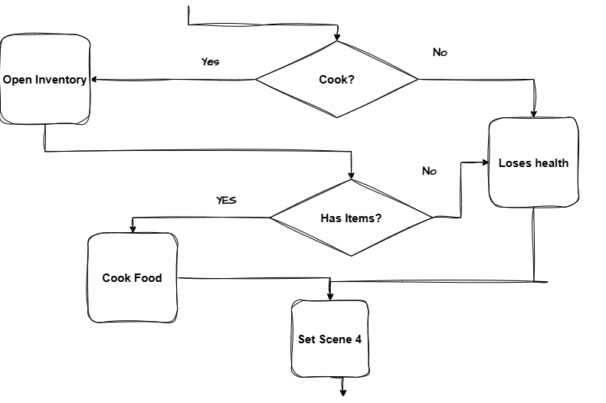
Flowchart
Scene 3

Slide 13
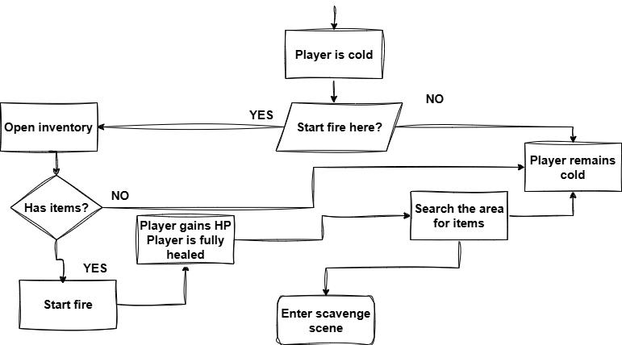
Flowchart
Scene 4

Slide 14
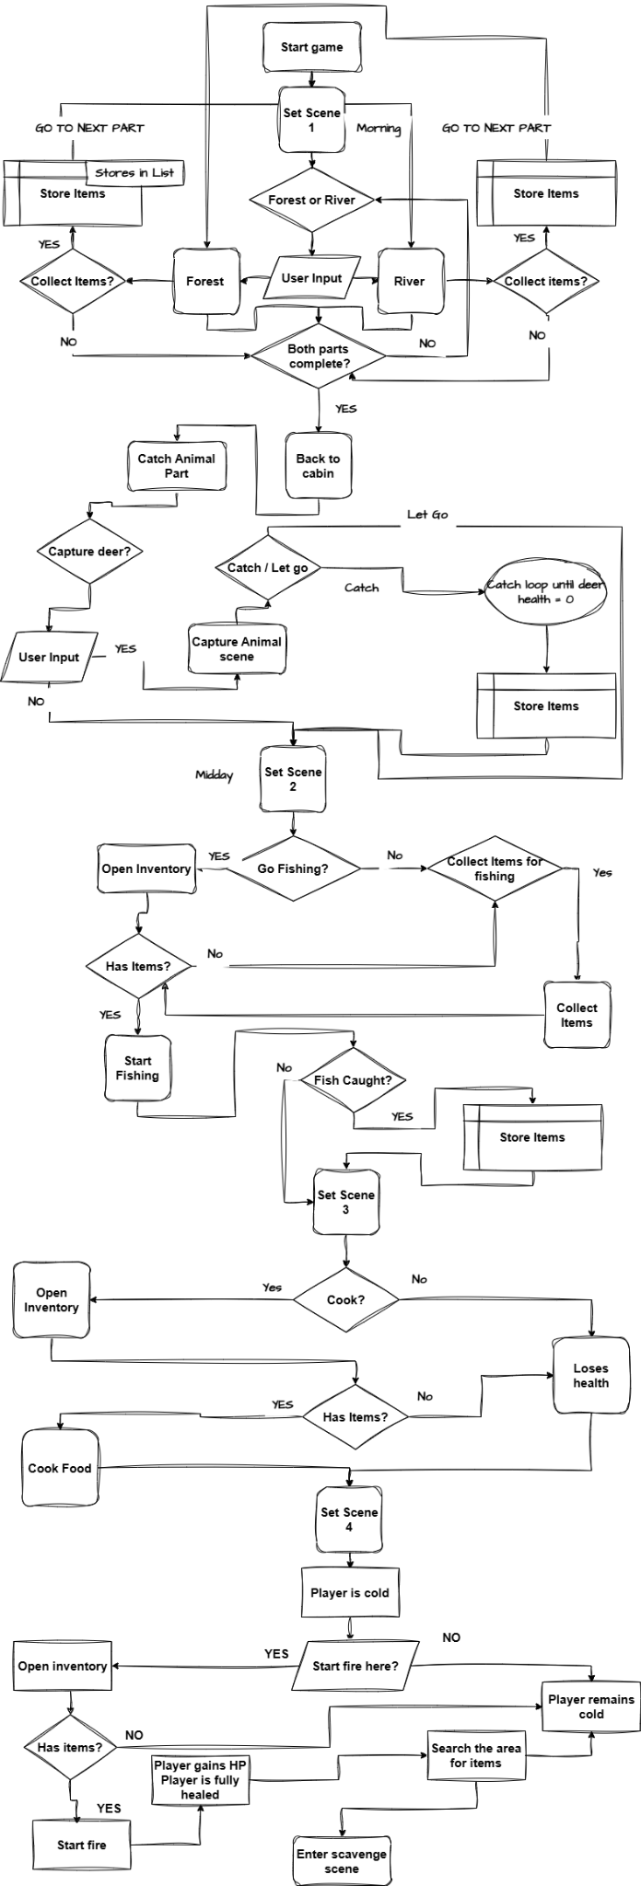
Flowchart
Complete Diagram
https://drive.google.com/file/d/183lkUJvrSmhpRnl7O2Niuify9LDzK2gJ/view?usp=sharing

Slide 15
Testing Phase

Slide 16
Testing
How did you test for bugs?
We tested for bugs by using different machines to run our code and we also tested for the flow of our game by comparing it to the original flowchart.
Was it effective
In short, yes. The quickest way to find an error on something we had coded would be to run it and see what happens.
What was the purpose of testing?
For each subsection the purpose was different, we could have a test run to see if the input was working or we could have a test to see if the whole section was working. We also took care to write the outcomes of our tests on Trello.

Slide 17
Embedding Front-end

Slide 18
Incorporating Front end
If you were to do this project again with front-end design too, what would happen?
We would have to:
Find different coding languages that suit the needs for the project (PyScript, ReactPy, StreamLit…)
Learn how they work
Think about design elements while coding each section of the game
Embed the code
The time to deploy would be hindered greatly for us, we had a group that was varied in experience with Python programming.
We already took enough time as it was to keep everyone up-to-date with the knowledge base of Python programming and some would even dedicate their time after hours.
Embedding front-end to our project would propose the risk of having to teach everybody that particular language and everyone would spend more time switching between learning and then coding. It would also change our flowchart design and we would then have to create a storyboard to demonstrate it’s visuals/

Slide 19
Team Slides

Slide 20
Makai Trott
What was your role?
During this project, I assumed the role of Project Manager and Team Spokesperson
Why were you given this role?
I was given this role as I am very comfortable with public speaking in any setting as well as being able to coordinate tasks between people of various backgrounds and abilities.
Were you able to complete tasks given?
Yes I was successfully able to complete the tasks presented to me.
Strengths
My strengths would be my ability to coordinate with team members
Improvements
Some improvements I would work on would be technical coding capabilities. While I do have confidence in my coding, there are improvements which can still be made.

Slide 21
Dylan Tong
What was your role?
Lead Developer
Why were you given this role?
I was given this role as I am very capable of testing and finding bugs in code as well as helping others to implement their ideas into coding language.
Were you able to complete tasks given?
I was able to complete the tasks given.
Strengths
My main strengths would be problem solving skills and workflow
Improvements
Some improvements I could make would be communication skills and time management

Slide 22
Fehintola Ogenah
What was your role?
I was given this role as to help oversee what has previously been done as I am capable
Why were you given this role?
I was able to complete the tasks given.
Were you able to complete tasks given?
My main strengths would be working on my workflow.
Strengths
My main weakness will be around communication and the length of time it took to complete my task.
Improvements
In future, I will to ensure that time is managed properly and ensure I communicate more effectively.

Slide 23
Sheikh Hussain
What was your role?
My role was project coordinator, keeping everything organised
Why were you given this role?
I was given this role as I have the ability to communicate effectively and efficiently.
Where you able to complete your tasks?
Yes, this did cause some slow downs as I also had to code elements in for my parts and plan,
.
Strengths
My strengths I would say would be that I was able to keep organised and punctual even on a ‘messy’ flow. We would have one member coding while another is still stuck on the flowcharts.
Weaknesses
Coding knowledge, though my knowledge on coding has greatly improved. I would like to see myself creating complex ideas.

Slide 24
Group Atmosphere

Slide 25
How was working in your team?
Was it good?
Our team just got on with what they needed to do and that’s thanks to the Kanban. We all worked well swiftly and everyone helped out.
Were stand-ups good?
Yes, these helped to keep everyone informed and if there was any problems we would have the opportunity to speak there and once vocalised everyone would seek to help.
Was Kanban effective?
This was the most effective tool for keeping our project organised. It’s simplicity against other development methodologies allowed each team member to focus more on what they needed doing and plan around what should be done.
How did you offer help?
We all offered help in the same way same as we asked for help, we would check at each point where someone was and what they needed doing.
How did you ask for help?
We would just message each other on teams, we had a group chat made with only us in there and we would just speak at the standups if we needed anything.
How did you all code?
We began coding individually to begin, we wanted to make sure that we all had coding experience and knowledge by the end of this project. As we got closer toward the end, more help was being handed out and so we started coding together and solving problems together.

Slide 26
Project Overview

Slide 27
Project Outcome
What went well?
We believe that the time to deploy for our project was brought forward and that’s because we were able to work very well within the team.
What would you do differently?
We would maybe spend more time with each other to try and get everyone on a ‘expert’ level in certain aspects of the project i.e. coding before we moved on from design phase. This would help with overarching project goal and allow room for a broader mindset in creativity and implementation.
How did you find Python while doing this project?
For the most part it was easy to first use, the problems only began when our ideas became complex. As we began coding we learnt that the simpler the idea was, the easier it was to code and so for that purpose we stuck to creating a game where it would at the base of everything do what the flowchart intended. If then we had this complete, we would move to improve.

Slide 28
Team Targets & Tasks
What did your tasks look like to hit these goals?
To make things even for everybody, we took precautions on delegating and creating tasks. The goal for the team overall was to create a working python project that runs with no bugs. We had team members at different levels in coding experience and comprehension. We still needed everyone to do equal amounts. So the project tasks were divided in to subtasks that were the exact same overall.
Describe your team communication for setting goals/tasks
This group in particular was great at team communication. Everyone knew what they were doing and everyone knew how and when to ask for whatever they needed. This level of transparency allowed the project to flow smooth. Most of us volunteered to take a task or our project lead would delegate to the suited member.

Slide 29
Going Solo
What experience do you think you would have if you tried making this game solo?
We would struggle with generating ideas, testing, and having a ‘birds eye view’ of the project. These though often undermined are actually very integral to forming and completing a project.
This is not to say that it can’t be done, more so to say that there would be no parameters for the implementation of the project whereby someone would stick to project tasks and goals rather than just embedding their ideas as it comes along.

Slide 30
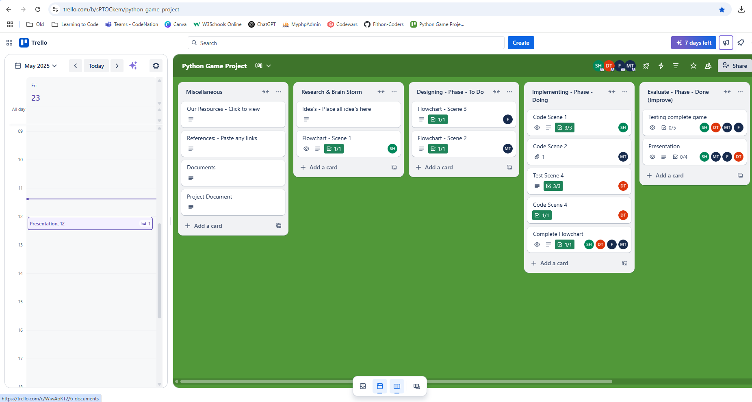
Trello
How did you find using Trello for your project, was Kanban any good?
Using Trello throughout our project helped greatly to keep everything organised. Using our Trello board in between tasks or for the ‘stand ups’ helped everyone know where each other were.
This way when it came to any of the project phases and tasks, we could easily read where we were, what we needed to do, a checklist of what needs to be done on each subtask or criterias and then move on swiftly to the next.
Unfortunately, we had to delegate the role of having a single person update or manage the workflow on their as when it came to integrating the application across different platforms to use with additional features it became a little complicated.
It would’ve been better if everyone only managed their own tasks and move it along the Kanban structure in Trello.
https://trello.com/invite/b/682701d9c3277b9861bceb1c/ATTIefd3332a7f8a0b611328a800600e053374167577/python-game-project

Slide 31
Teams
How did you find using Microsoft Teams for your project?
We all used this as our main form of communication and file sharing within the team. We had alternatives and used them a little like Google Drive, the problem was that everything was then scattered across different platforms.
Therefore, we strategised to organise our project by uploading the final files to Google Drive and then linking them to whatever tasks in Trello. Teams was then used as our filehub where we created a group chat and in that group chat all files, messages and calls where done if needed. Without Teams, this project would’ve displayed some slow downs through each phase.
The downside to teams was that when it came to integrating Trello as per their features it actually proved quite difficult to use. It wasn’t user-friendly as we expected and so we just stuck to using Trello on it’s external platform as it is.

Slide 32
https://venngage.com/blog/flowchart-symbols/ https://boardmix.com/knowledge/flowchart-symbols-explained-from-basic-to-advanced/
https://www.geeksforgeeks.org/print-lists-in-python-4-different-ways/?ref=lbp
https://discuss.python.org/t/lists-how-to-print-specific-item/62524
https://codedamn.com/news/python/how-to-check-for-specific-elements-in-list-in-python
https://www.edureka.co/blog/python-list-remove/#:~:text=How%20do%20I%20remove%20a,also%20return%20the%20removed%20item.
https://www.geeksforgeeks.org/check-if-value-exists-in-python-list-of-objects/
https://dictionary.cambridge.org/dictionary/english/role-playing-game
https://www.forbes.com/sites/technology/article/what-are-rpg-games/
https://trinket.io/python/e5a03e7cbc
https://www.youtube.com/watch?v=VchuKL44s6E
https://www.businessnewsdaily.com/4987-what-is-agile-scrum-methodology.html
https://interactivechaos.com/en/python/function/randomuniform#:~:text=The%20random.,to%20extract%20the%20random%20number.
https://www.topcoder.com/thrive/articles/pyscript-python-frontend-framework#:~:text=PyScript%20framework%20allows%20developers%2Fprogrammers,the%20code%2Fprogram%20more%20accessible.
Our References

Slide 33
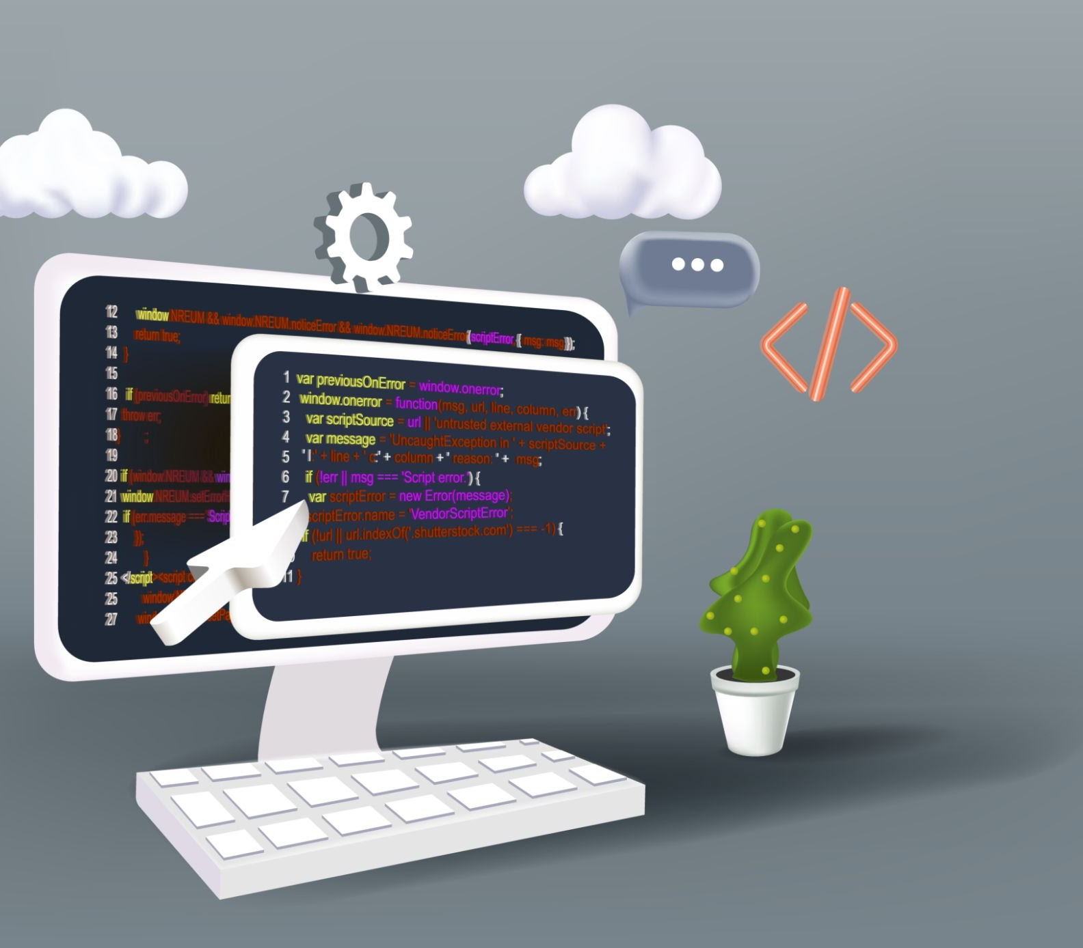
Any Questions?
“Fithon Coders”
Survivor In The Wilderness text-based Python Game
Designed & Developed by:
Makai Trott
Dylan Tong
Fehintola Ogenah
Sheikh Hussain
@Code Nation

